Slide 1

ISLAMIC CREDIT UNION -
AN INCLUSIVE FINANCIAL INSTITUTION TO MEET THE NEEDS OF THE COMMUNITIES IN AFRICA
AL BARAKAH
multi-purpose Co-operative Society Limited
H.O.: Madam Lolo Street, Rose Belle, Mauritius
Tel: (+230) 6275766
E-mail: albarakahcoop@yahoo.com; www.albarakahcoop.org
5th African Islamic Finance Summit
17 – 18 April 2018 │Tanzania

Slide 2
Agenda
Introduction: The Islamic Finance industry
The Cooperative Movement & Credit Unions
Credit Unions Worldwide
The Credit Union Movement and Islamic Financial Institutions
Islamic Credit Unions
Setting up Islamic Credit Unions
Financing Instruments of Islamic Credit Unions
Reserves and other Funds of Islamic Credit Unions
Challenges
Conclusion

Slide 3
The Islamic Finance Industry
Evolution and Growth
The modern experiment of profit and risk-sharing business, which is the cornerstone of Islamic banking business, first undertaken in 1963 in Mit Ghamr, had as purpose the exploration and investigation of the possibilities of mobilizing local savings and credits as an essential requirement for socioeconomic development in the area. (El Naggar, 2006).

Slide 4
The Islamic Finance Industry
Evolution and Growth
Emergence of IFIs since 1960 & growth - IBFI - a reality in Muslim majority as well as Muslim-minority countries and its share in the global market is increasing day by day.
Observation – satisfaction: growth, IFIs, Islamic windows; Global IF Assets = $2 trillion at year-end 2016; > 50 IFIs in Africa out of 600 institutions globally (MIFC, 2017)
Critics: mimicking the conventional products - whether IFI are achieving the Islamic ideals of economic justice, providing necessities of life and well-being of the community, good life and spiritual peace are available to society at large – encouraging consumerism
IFI – to mobilise resources to promote development in a Shari’ah-compliant manner.

Slide 5
The Islamic Finance Industry
Islamic Financial Institutions
B.Model - Types of IFI: F-B-T-L-FH
Dominance by ICB (HNW) & neglected areas like Islamic microfinance & institutions/ Model like cooperatives which are - CBO and have economic as well as social objectives.
Experiment of Dr. Naggar of mobilizing savings and credits for socio-economic development
Back --- IBF evolved through the cooperative sector - acted as a stepping stone

Slide 6
The Cooperative Movement & Credit Union
Idea of helping each other / joint efforts to achieve a common goal
1844
Rockdale Pioneers
On 24th October 1844, in Rockdale, Lancashire, England, a group of people faced with economic exploitation and deprivation set up a cooperative store based on the principles of self-help and mutual help. They defined a set of principles which became the basis for the cooperative ideology which soon spread all over the world.
1852
Cooperative Bank in Germany
In 1852, Franz Hermann Schulze-Delitzsch set up a Cooperative bank in Germany and Friedrich Wilhelm Raiffeisen developed the movement further (Moody and Fite, 1984).
1888 – to date
Further Developments
By the time of Raiffeisen's death in 1888, credit unions had spread to Italy, France, the Netherlands, Austria, and to many other nations. The Cooperative Movement has spread all over the world be it a capitalist, socialist or Muslim society

Slide 7
The Cooperative Movement & Credit Union
“an autonomous association of persons united voluntarily to meet their common economic, social and cultural needs and aspirations through a jointly owned and democratically controlled enterprise.”
Bodies: ICA represents 306 co-operative federations and organisations in 105 countries (Nov 2017).
Main objective of establishing cooperatives is the promotion of the economic, social and cultural welfare of its members according to cooperative principles.
Business activity : consumer, producer, marketing, agriculture, fishing, housing cooperatives, financial cooperatives - Credit Unions
PRINCIPLES
  Voluntary and open membership
  Democratic member control
  Member economic control
  Autonomy and independence
  Education, training and information
  Co-operation among co-operatives
  Concern for community
Source: International Cooperative Alliance (ICA)

Slide 8
Credit Unions
“A credit union is a particular form of cooperative bank. Specifically, a credit union is a not-for-profit cooperative financial institution that is owned and controlled by its members and operated for the purpose of promoting thrift, providing credit at reasonable rates, and providing other financial services to its members.”
Africa
SACCOS (Savings and Credit Cooperative Societies)
Afghanistan
Islamic Investment and Finance Cooperatives (IIFCs)
Indonesia
Egypt
Savings and Credit Association known as the Gam’iya
Bait ul Maal wat Tamweel (BMTs)
Credit Unions
Throughout history the model has proved that it is one that may be adapted to the needs of different population groups, different cultures, languages, and religions, as well as to different legal, political, and economic systems.

Slide 9
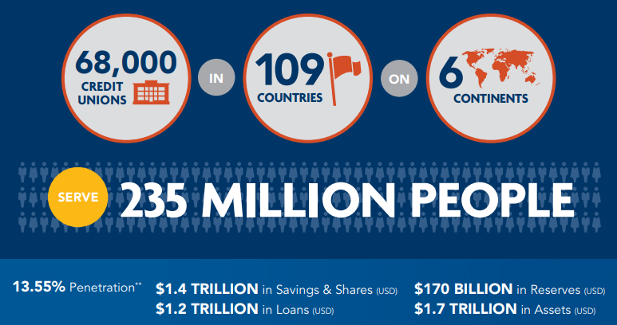
Credit Unions Worldwide
WOCCU Statistical Report 2016
** Penetration rate is calculated by dividing the total number of reported credit union members by the economically active population age 15-64 years old.

Slide 10
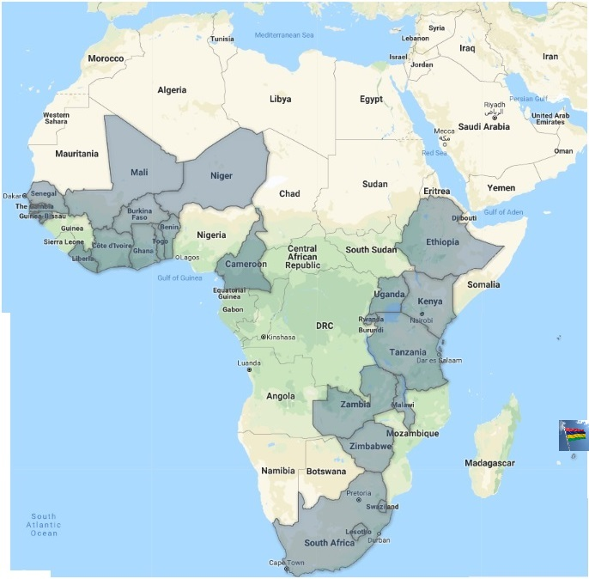
CU in Africa: 25 countries, CU - 21724, Members - 23,248,774
SADC ( 14C ) , COMESA (19C)

Slide 11
Credit Unions / Financial Cooperatives
Core Features
Membership
  People from all walks of life
  Common bond (place of work, same organization, community-based)
Ownership: member-owned organization
Democratic – OMO Vote
Capital - Financial dignity - shares, savings and deposits from
members
Financing - savings precedes financing – spirit of savings, multiplier
(1x3)
No maximization of profit/Satisficing concept
  Surplus/profit returned to shareholders in terms of dividend, patronage bonus, lower fees, reserves and better services

Slide 12
Islamic Credit Unions / Islamic Financial Cooperatives
ICU refers to retail financial services in compliance with Islamic financing principles.
Islamic Credit Unionists – efforts on several fronts over the past 50 years to promote and set up ICU around the globe.
UK alone has 22 fully fledged Islamic Investment and Finance Cooperatives (IIFCs) (WOCCU, 2013).
During the past years, WOCCU has built a network of Islamic Investment and Finance Cooperatives across Afghanistan providing Murabaha, Ijara and other products to these member-owned cooperatives.

Slide 13
Islamic Credit Unions
Tracing History
1890
India
Efforts in the organized sector under the style of the Patni Cooperative Credit Society was established in 1942, almost immediately after the adoption of the Indian cooperative Act 1940 (Dr. Rahmatullah-IFFI of India in crisis/Bagsiraj-IFII, published by KAU, Jeddah-2003)
1980 - 1982
During the period 1980-1982, Alhaji Saiyadi Ringim, Chairman of NASCUN (the Nigerian credit union federation) and also Chairman of ACCOSCA (the Panafrican credit union confederation) undertook a mission to Cairo, Egypt whereby he consulted Islamic scholars about the application of Islamic law to economics and finance and about the feasibility of credit unions in Muslim societies (Alhaji, 1982).
1987
Thailand
“History of Islamic Financial system in Thailand started with the establishment of a cooperative society, Pattani Islamic Saving Cooperative that operates based on Shari’ah in 1987… (Haron & Yamirudeng)
1960
“Formal Islamic banking first emerged in the early 1960’s through credit unions of Muslim landowners in Egypt and Pakistan who simply pooled their resources and could then in turn draw out funds for agricultural improvements on a non-interest basis.” (Prof Rodney Wilson)
Egypt and Pakistan
2003
India
2006
I.ALI , Founder of Muslim Credit Union Co-operative Society Ltd, Trinidad & Tobago, submitted a concept paper to the IDB, Jeddah, Saudi Arabia as an initiative to the promotion of Islamic finance through the cooperative and credit union system.
T & T , 2006
Study shows that there are institutions that have grown to a size of 14 Islamic Cooperative Credit Society (ICCS) in India. Bagsiraj, 2003

Slide 14
Islamic Credit Unions in Muslim-majority & Muslim-minority Countries
Credit Union | Country | Year | Main Products / Remarks
Koperasi Muslimin Malaysia Berhad | Malaysia | 1980 | Bai Bithaman Aajil; Muslim Welfare Scheme (Al-Abrar); Qard Hassan
Ansar and Islamic Co-operative Housing Corporation Ltd. (ACHC) | Canada | 1981 | Interest-free home ownership and investment opportunities
Muslim Credit Union Co-operative Society Limited | Trinidad & Tobago | 1983 | NA
Pattani Islamic Saving Cooperative | Thailand | 1987 | NA
Muslim Community Co-operative Limited | Australia | 1989 | Facilitated over $750 million in Islamic home finance and manages close to $30 million in investments.
Qurtuba Housing Co-op | Quebec, Canada | 1991 | Musharaka house financing
Loans and Savings Abertawe (LASA) Credit Union Ltd | Swansea, Great Britain | 1992 | Conventional credit union offering Shari’ah compliant savings and finance products to its members (Hajj Fund, Marriage Fund; Funeral Fund, Murabaha and Wakala)
Ameen Housing Co-operative of California, Inc. (AHC) | California | 1996 | Investments and home financing
Islamic Co-operative Finance Limited | Australia | 1998 | Housing and vehicle finance; Hajj fund; Qard Hasan (Benevolent) fund; Children Education fund; small business finance; finance for other household goods
Al Barakah Multi-purpose Co-operative Society Limited | Mauritius | 1998 | Murabahah; Istisna; Ijara, Qard Hasan; Hajj Savings Account; Cooperative Solidarity Fund/ Micro Takaful

Slide 15
Islamic Credit Unions in Muslim-majority & Muslim-minority Countries
Credit Union | Country | Year | Main Products / Remarks
Takaful T&T Friendly Society | Trinidad & Tobago | 1999 | Funeral Benefit; Hajj Fund; Investment Fund; Waqf (Cash Waqf, Real Estate Waqf); Property Ownership
FML Multi-Purpose Co-operative Society | Fiji Islands | 2004 | NA
Balkh Savings and Credit Union | Mazar-e-Sharif, Afghanistan | 2004 | NA
Jawsjan Savings and Credit Union | Sheberghan, Afghanistan | 2004 | NA
Manzil Co-operative | Trinidad & Tobago | 2006 | NA
Al Islamiah Saving Cooperative | Thailand | NA | NA
Amwal Credit Union | Hong Kong | 2009 | Ijarah; Murabaha; Istisna'a; Musharakah; Wakalah; and a variety of accounts and wealth management services
Janseva Cooperative Credit Society Limited | India | 2010 | Various types of Demand and Term Deposits Accounts; Murabaha; Mudaraba; Musharaka; Ijarah and many others
Assiniboine Credit Union (ACU) | Winnipeg, Canada | 2010 | First bank to offer Islamic mortgage services exclusively at one of ACU’s branches
Islamic Credit Union of Canada (ICUC) | Canada | NA | http://www.icucan.ca/home
NA: Not Available
Source: Computed

Slide 16
Setting up Islamic Credit Unions
Conceptual Framework
“Cooperate with all in what is good and pious and do not cooperate in what is sinful and wicked…” (Q-5:2) - Ta’awoun
Legal Framework – Easy formation, less regulated than other corporate sector (Cooperatives Act ,Credit Union Act); Shari'ah-compliant - WOCCU
Values-based model - IF based on Islamic ethics/values: justice, sharing, solidarity
  Coop based on values: honesty, equity, solidarity, self-help, mutual-help etc.
Common bond - IB
CBO / Member-owned organization
Small seed capital – SVG
Incentives & Benefits – Tax Relief
Multi-purpose - open to various types of economic activity
Broaden ownership of business
Reduce concentration of wealth
Democratisation of the Islamic Financial System (SMF Inst.)

Slide 17
Islamic Credit Unions
Formation & Organization
Founder members - Initial contribution of those who are conscientious and committed people to provide an alternative to the interest-based institution
    Democratic Structure / Management / Board & Sub-committees
    Shareholdings / Membership / Financial inclusion / Returns
      Open to people from all walks of life, established by the people, for the people
      CBO - Member-owned society where the spirit of ownership and sense of belonging to an Islamic financial institution will be present.
      Financial dignity by mobilizing capital/funds from the community/members - shares, savings and deposits and offering financial services to those who lack access to financial services
      Not-for-profit-maximization - reasonable profit on financing products
      Returns to shareholders/members
Organs of Control, Audit & Good Governance
  AGM - Internal Controller, External Auditor and Shari’ah Supervisory Committee to ensure that the affairs of the institution are conducted in accordance with Shari’ah and within provisions of the Law of the country

Slide 18
Islamic Credit Unions
Marketing
  Lack of awareness of Islamic finance.
  Correcting misconceptions about ICU - not a charitable institution or a benevolent society but a business organization operating on Islamic lines for the community.
  Word-of-mouth marketing
Education & Training/ Human Resource
  Islamic Finance Education Program (IFEP) for existing and potential members
  Topics and aspects such as Conceptual Framework of IF, Basic Islamic Financial Laws, Quranic Verses concerning the economic system of Islam, Ethics and operation of the ICU.
  Weekly/Fortnightly education sessions for members and their beneficiaries/dependents/sureties
  Location - Inception stage - Mosques, Islamic educational institutions, and centers can be used for these activities.

Slide 19
Islamic Credit Unions
Financing Instruments
Murabahah (Cost- plus financing)
Ijarah (Leasing)
Reserves and Other Funds
Statutory Reserve
Dividend Equalisation Fund
Musharakah (Joint venture)
Istisnah (Construction Finance)
Salam (Forward purchase of a commodity)
Mudarabah (Passive Partnership)
Musharakah Mutanaqisa (Diminishing Musharakah)
Qard- (Interest-free loan)
Profit Equalisation Reserve
Zakah Fund
Takaful Ta’awuni Fund

Slide 20
Challenges
Individual Level: Change in the mindset of individuals – to perceive and appraise Islamic finance from an Islamic perspective rather than looking from conventional binoculars.
Organizational Level: Org can play a key role towards the promotion of ICU - setting up their own ICU or be fervent supporters of such institutions.
Community Level:
Whole community will benefit if they take the initiative to bring about the desired change as Allah says: “…Indeed, Allah will not change the condition of a people until they change what is in themselves…”
(Ar-Ra`d 13:11)
People have to learn to live a modest and balanced material and spiritual lifestyle/good life (Hayat tayyiba) to attain success (falah).

Slide 21
Challenges at various levels
Government/Regulators Level
-Must support community-level financial institutions by providing a favorable legal framework, and tax incentives .
Global Level
  Prevalence of ICU globally, need for international bodies such as AAOIFI, ISRA, IFSB and IDB to at least establish a special unit or department for development of this sector.
  WOCCU - Established Islamic Investment and Finance Cooperatives in Afghanistan (2004–2012) and now shifting its attention to Libya.

Slide 22
Conclusion
ICU is in line with both cooperative and Islamic principles.
Financial services to all strata of the community and opportunities of managing the wealth of the community in a Shari’ah compliant manner.
Enlighten members - Not to be interested only with the economic benefits of the institution but also with the spiritual and conceptual part
Prepared to face challenges, inconveniences or difficulties that will be unavoidable at the infant stage of the institution.
Concern for community - ICU can embark everyone on board as a stakeholder -job of everybody…….

Slide 23

ISLAMIC CREDIT UNION
AN INCLUSIVE FINANCIAL INSTITUTION TO MEET THE NEEDS OF THE COMMUNITY
Thank You
Mr. Mamode Raffick NABEE MOHOMED
Founder & Secretary
AL BARAKAH MCSL
E-mail: albarakahcoop@yahoo.com
rafficknm@yahoo.com
www.albarakahcoop.org
Tel: (+230) 6275766, Mb. (+230) 57781738

